Slide 1


ECEN 403 Final Presentation SolarEye Security System
Team members: Alex Allahar, Victor Igbokwe, Jackson Kitchel, Zayan Prasla
Sponsor: Dr. Jang

Slide 2
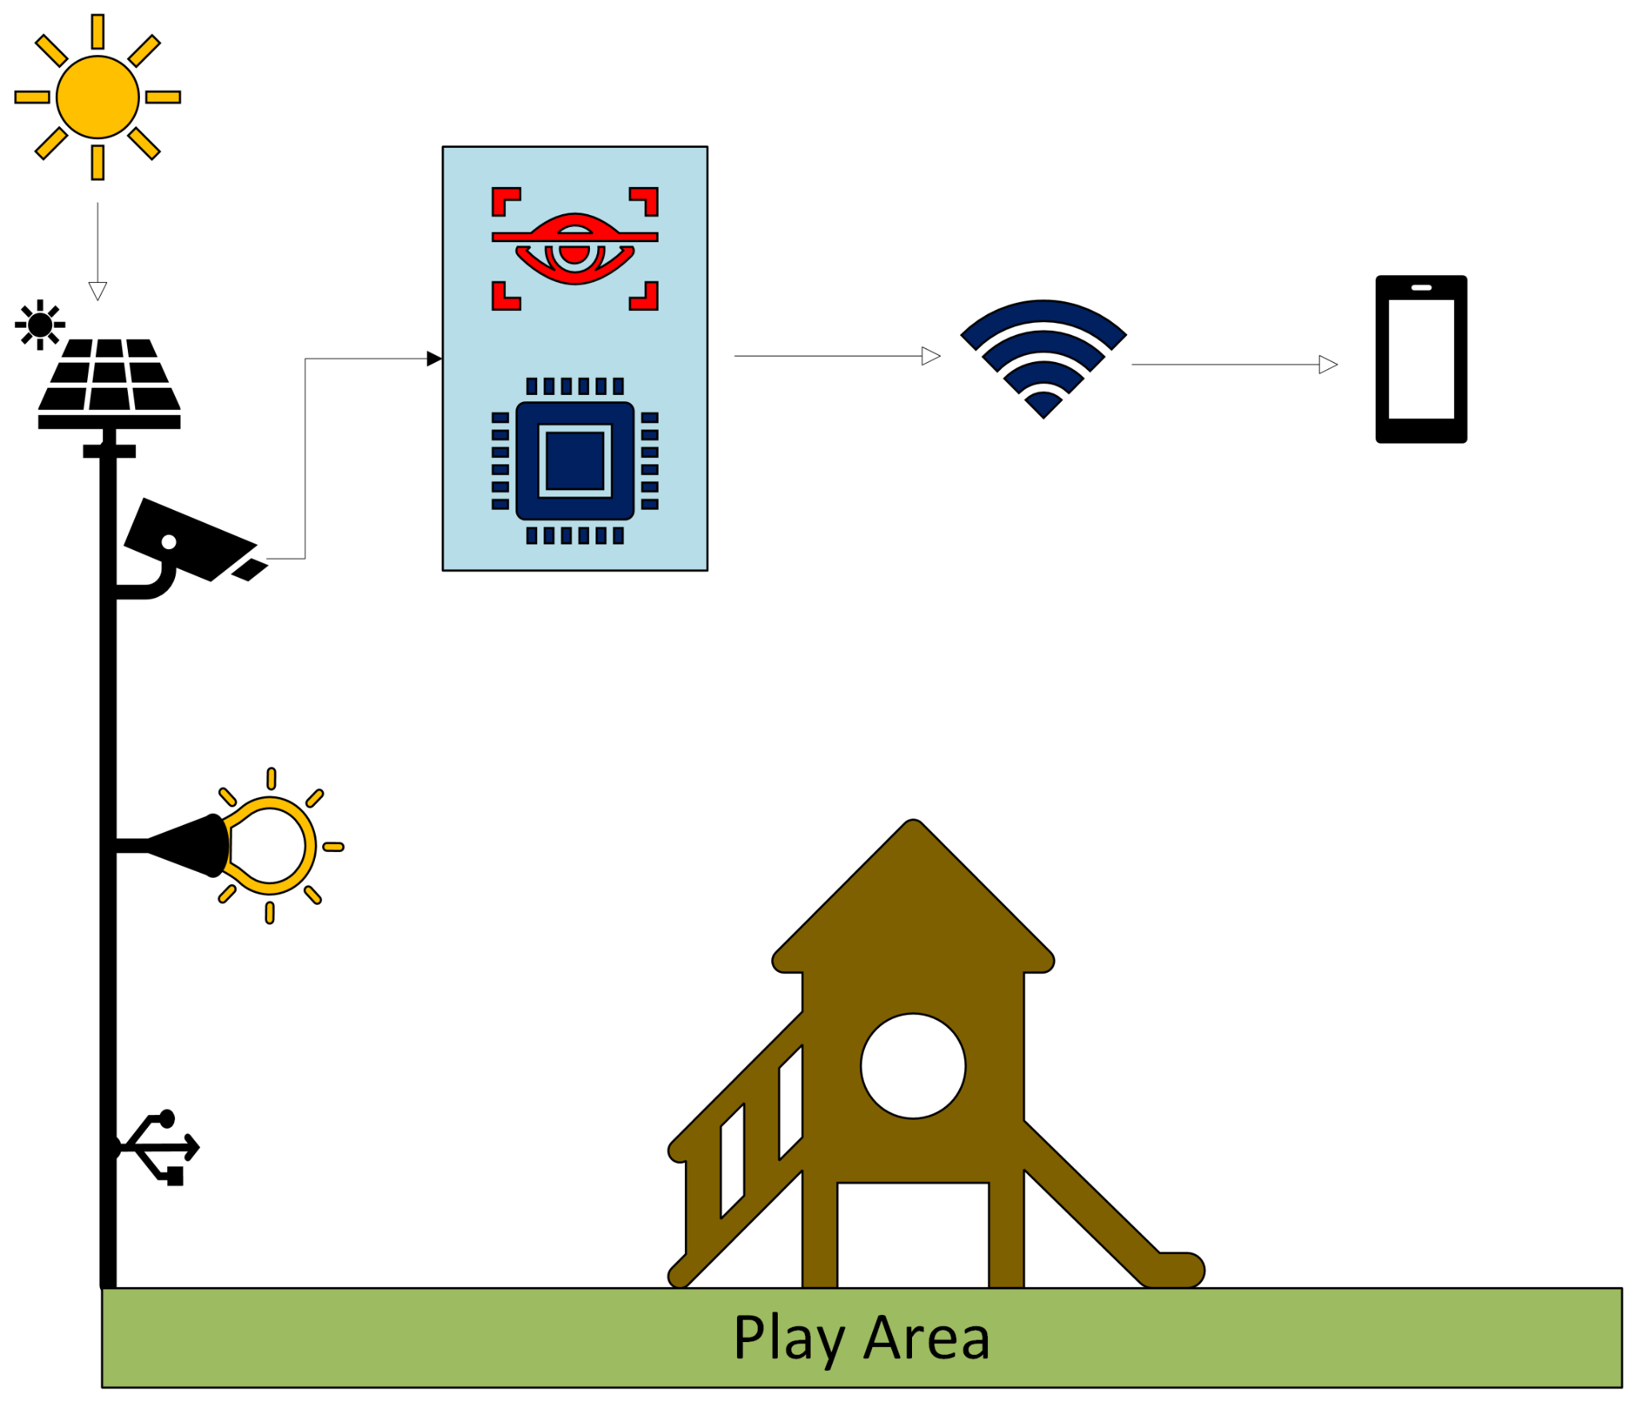

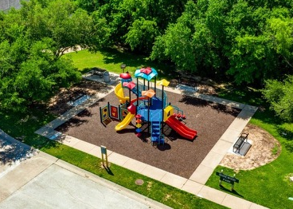
Problem Overview
A solar-powered security system with a motion-detecting camera. This system provides near real-time video feeds and send automated alerts for suspicious activity through a mobile app, enhancing safety in these areas.

Slide 3
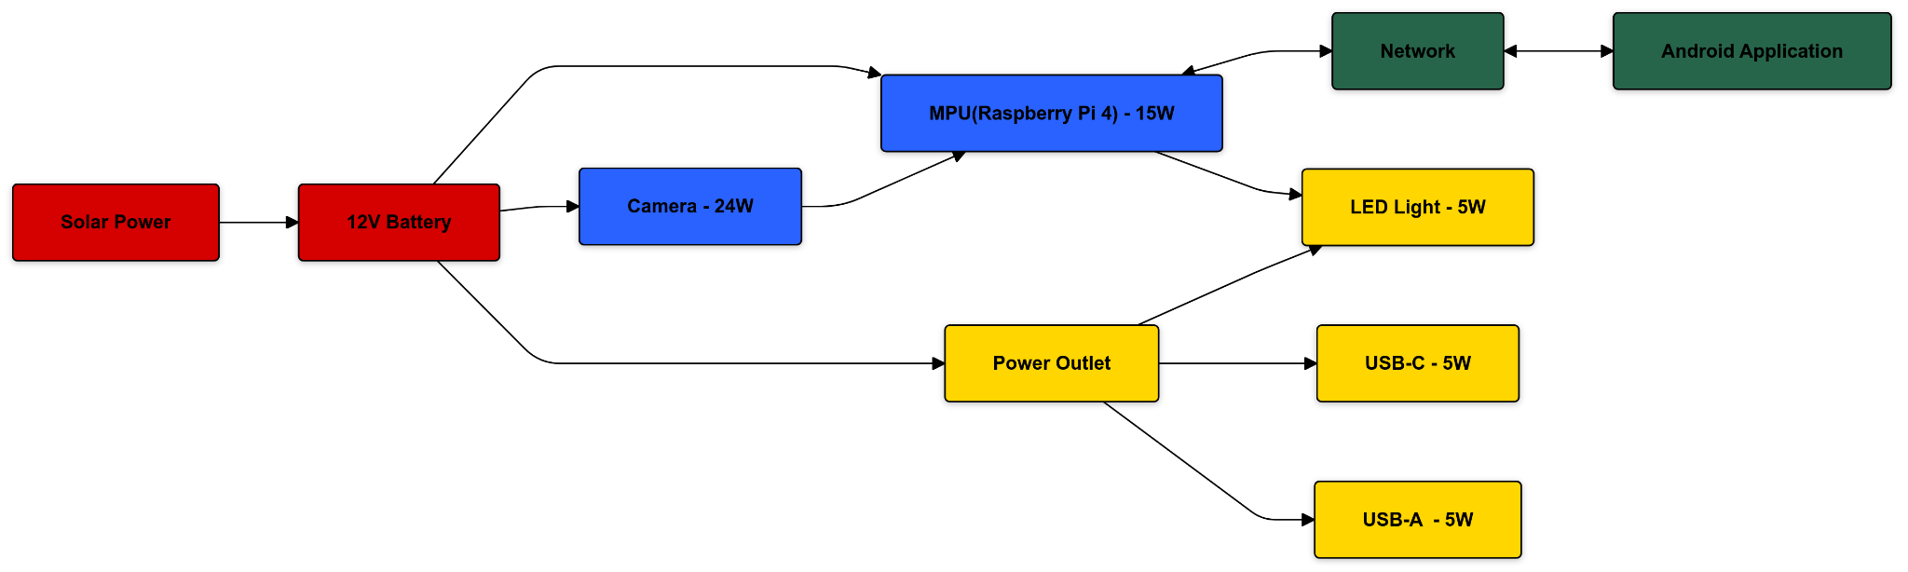
System Diagram
Red - Jackson Kitchel (Power Generation)
Yellow - Victor Igbokwe (Power Distribution)
Blue - Alex Allahar (Microprocessor & Detection)
Green - Zayan Prasla (Network & Application)
Notes:
This is where task partition is stated, Alex

Slide 4
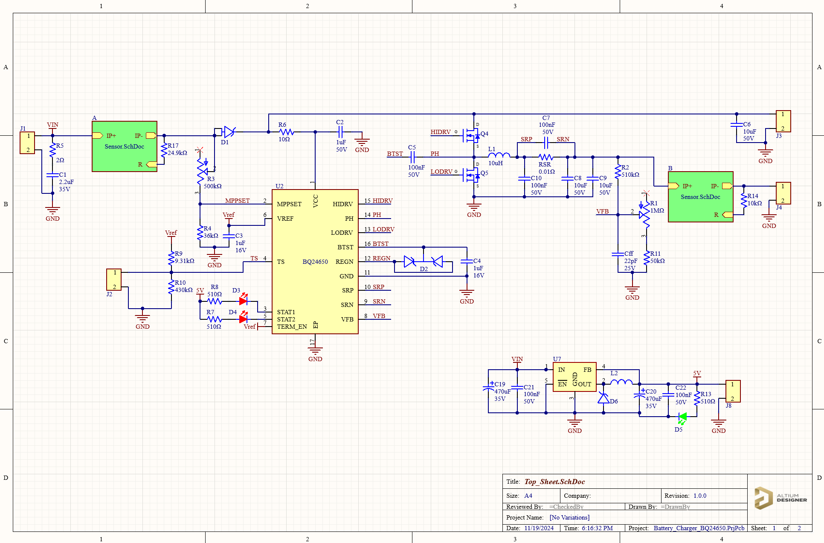
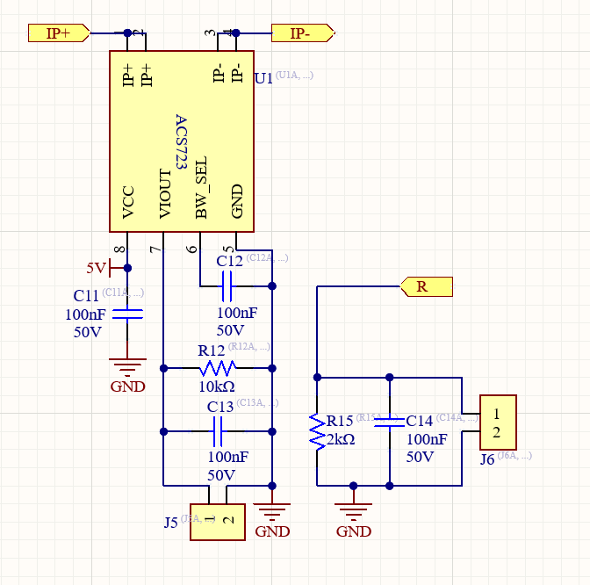
Subsystem 1: Power Generation
PCB responsible for power generation from the solar panel to the battery
Battery supplies power distribution PCP with 12V
Charging circuit automatically cuts on/off
Provides MCU with voltage and current readings at the solar panel and battery

Slide 5
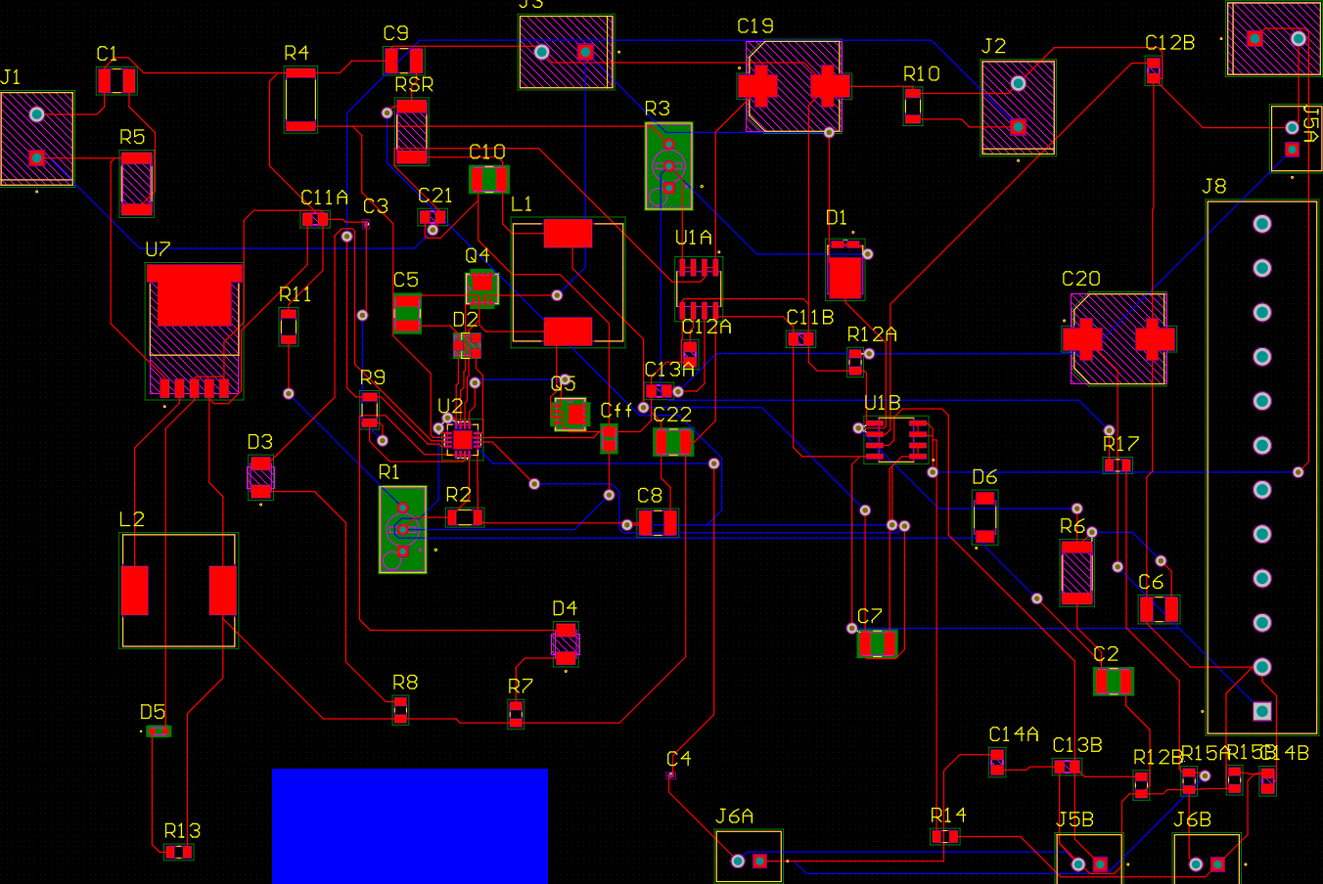
Subsystem 1: Power Generation
Ongoing Tasks:
First PCB scrapped
Soldering and testing PCB (ie. short circuit, continuity)
To do in 403:
Battery charging test
Cut on/off test
Demo
To do in 404:
Integrate power with distribution subsystem
Integrate voltage/current readings with MCU subsystem

Slide 6
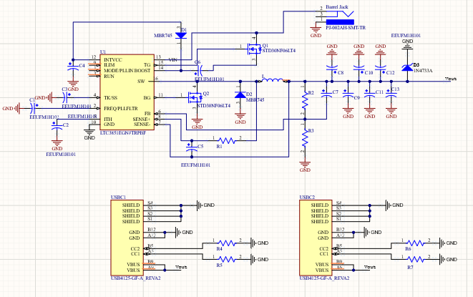
Subsystem 2: Power Distribution

Slide 7
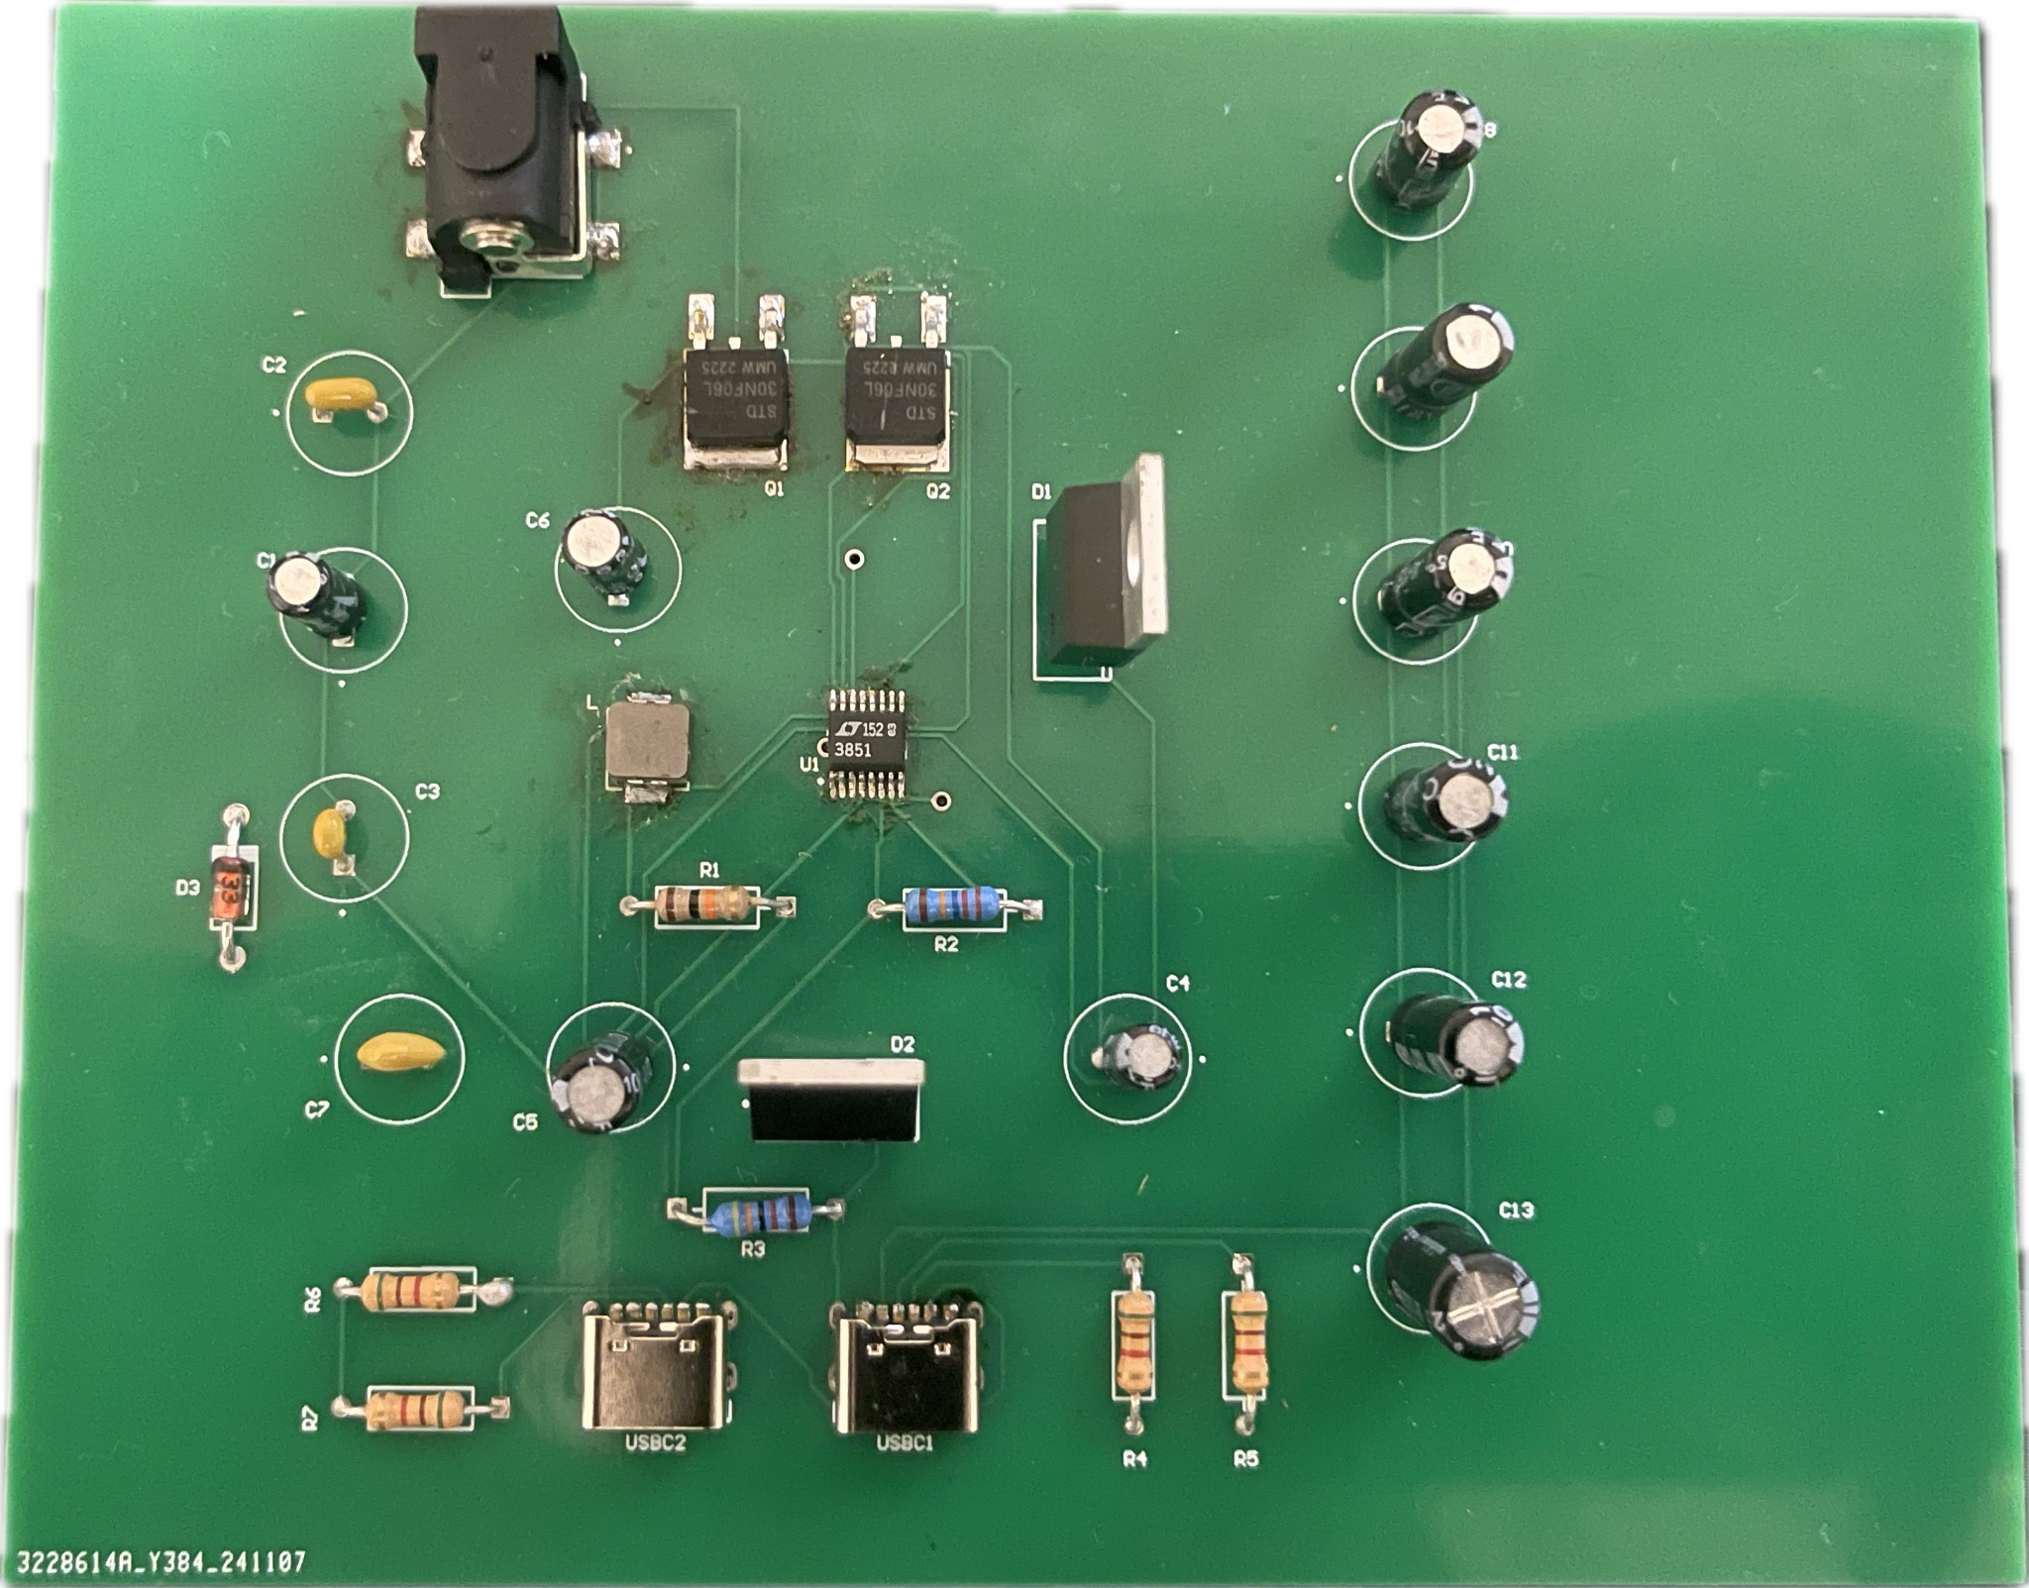
Power Distribution Cont.
Completed Tests
Continuity Test: Use a multimeter to check continuity between connected pads and traces to ensure no open connections exist.
Short Circuit Test: Verify there are no shorts between the power (5V and 12V rails) and ground. Measure resistance between 5V and GND and 12V and GND. It should not show a short (low resistance).
Concerns
Vin Connection: Experiencing difficulties with the connection between the MOSFET and the Vin pin of the IC chip.
Proposed Solution
Perf Board: Use an external Perf board to solder a connection between the mosfet and Vin.
To Do (403)
Output Voltage Test
Load Test
To Do (404)
Voltage Regulator load Components
Integration with other subsystems

Slide 8
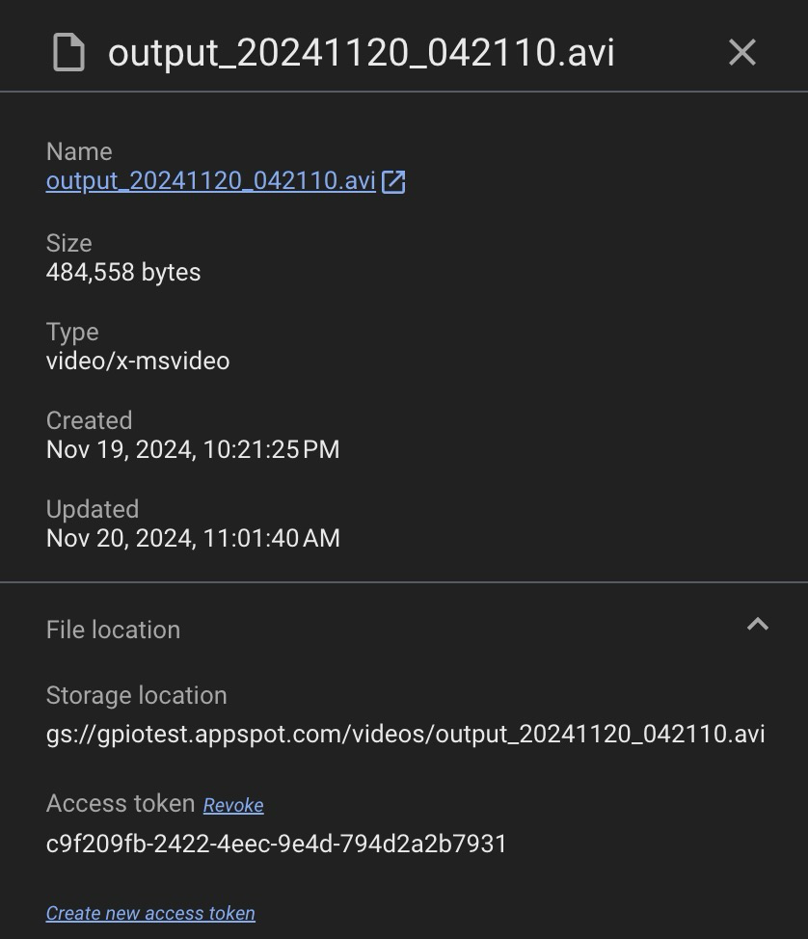
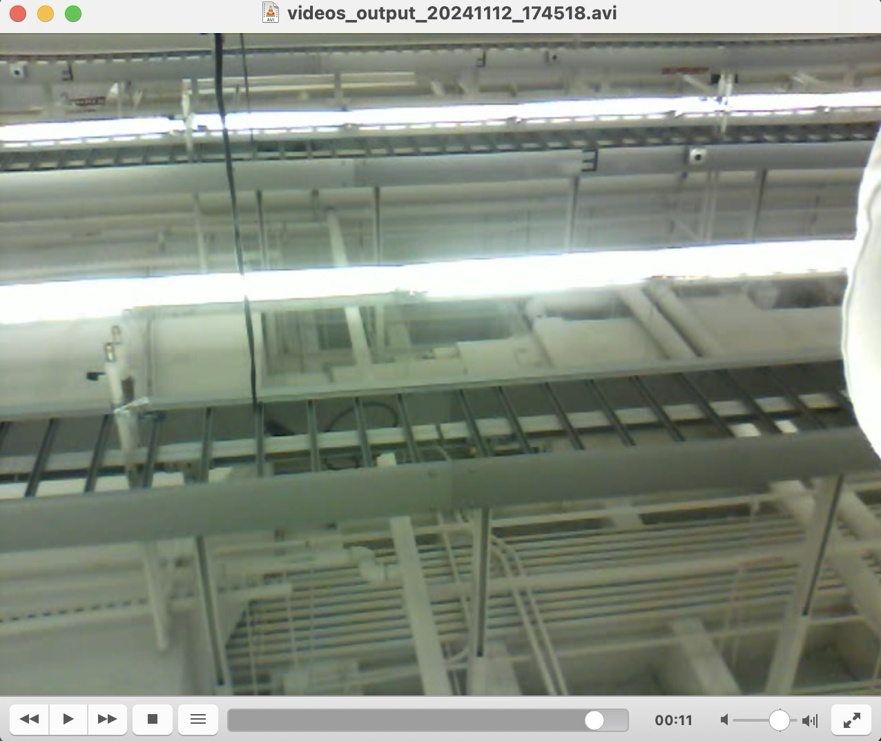
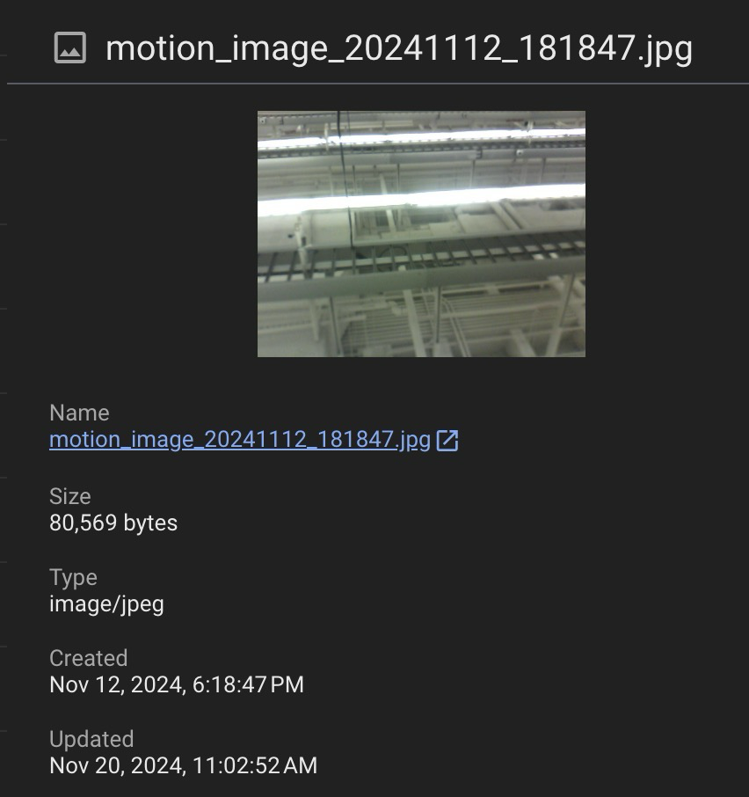
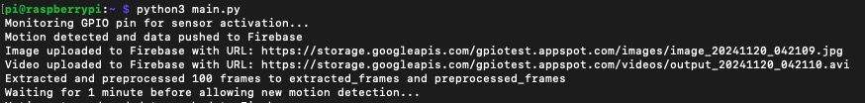
Detection: Modes of Operations
Low-Power Mode
Passive (Security)
PIR Sensor Activated
Automated Video Capture
Fixed / Variable
Generate Thumbnails
Send Video Capture
Operational Mode
Active (Surveillance)
Motion / User Activated
Real-Time Video Stream
OpenCV Motion Detection
Send Alert to Firebase
Low-Power Mode Output

Slide 9
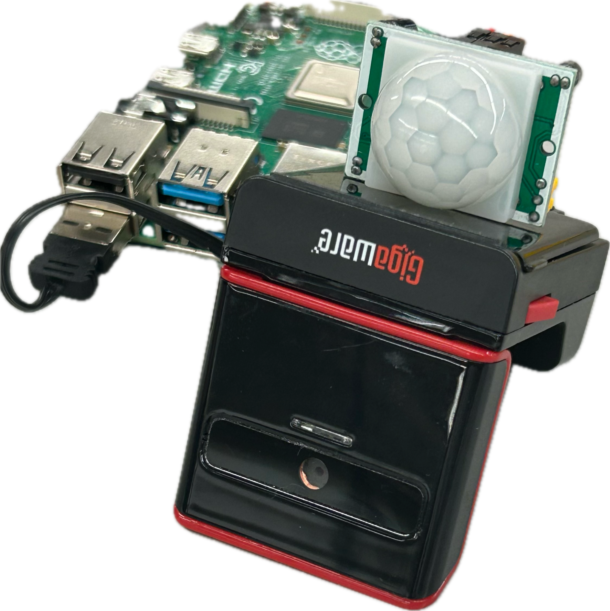
Detection: Tasks
Completed:
PIR Sensor functional up to 5 ft Range, with a FOV of 120°
Minimize delay between motion detection and video capture stored on Firebase.
Thumbnail Generation accessible by Firebase.
Event History Local and Firebase Storage.
To-Do (403):
Measure Raspberry PI Memory and CPU Usage during Modes of Operation.
Verify MPU can stream to local network via HTTP Protocol.
Fine Tune Yolo V4-Tiny model for better performance on object detection.
To-Do (404):
Connect Detection Database with SolarEye Android App
Implement Listener Functions to allow app to control modes of operation.
Integrate MPU and Camera with Power Distribution Subsystem.
Install trained Yolo V4-Tiny Object Detection Model on MPU.

Slide 10
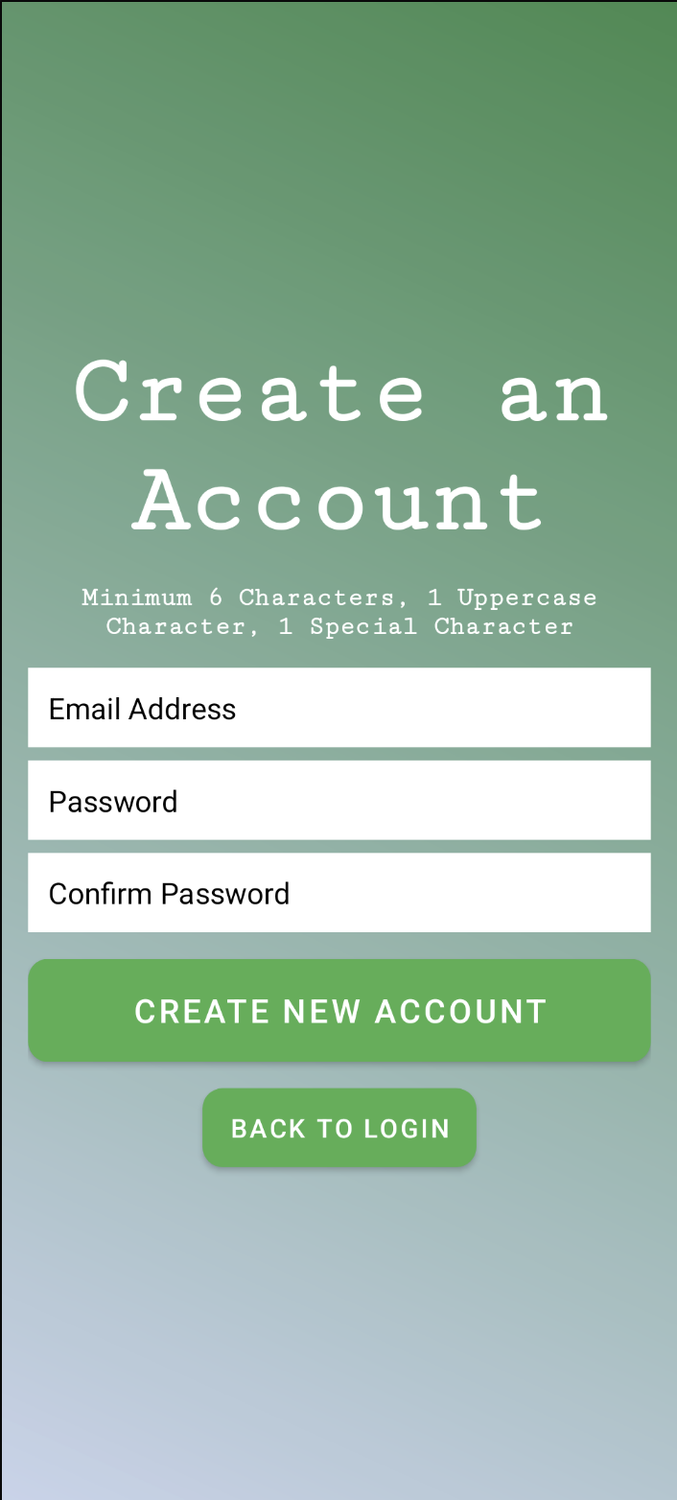
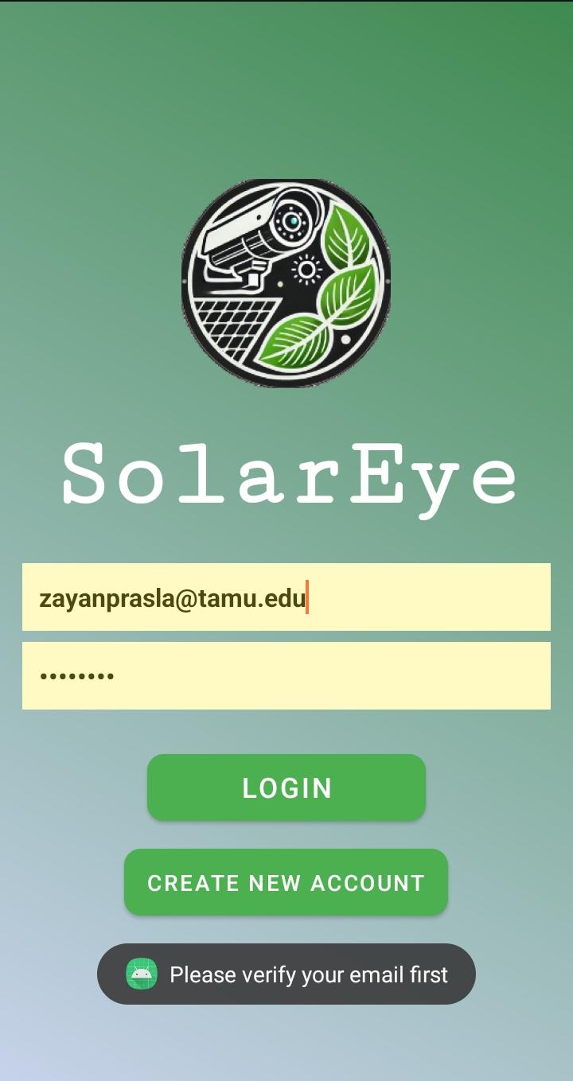
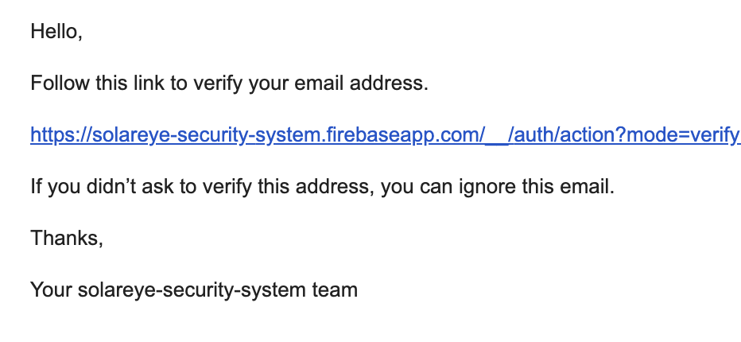
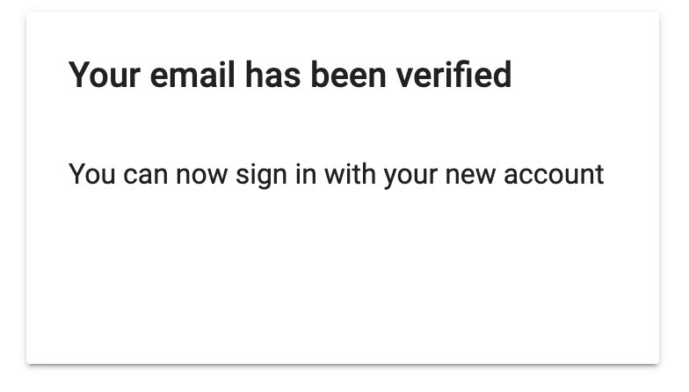
Subsystem 4: Software/App
Login Page:
User Login saved on Firebase Auth
Email must be verified to login
User remains logged in until they manually log out
Account Creation:
Email Verification
Verification Link expiration
Password Policy
Email Verification:

Slide 11
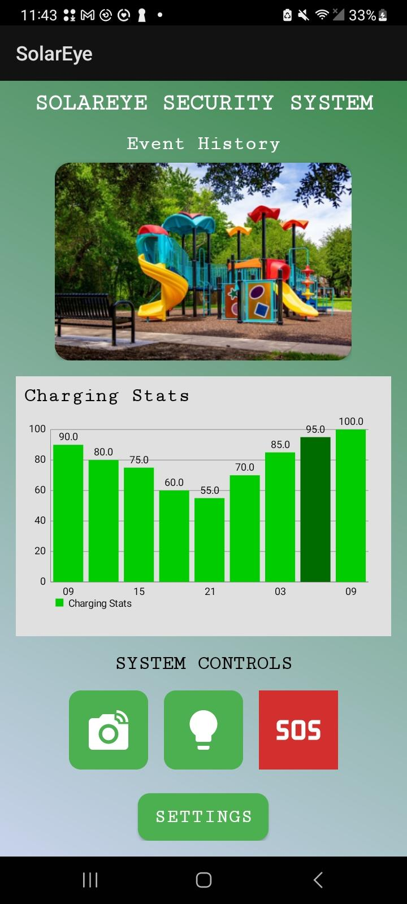
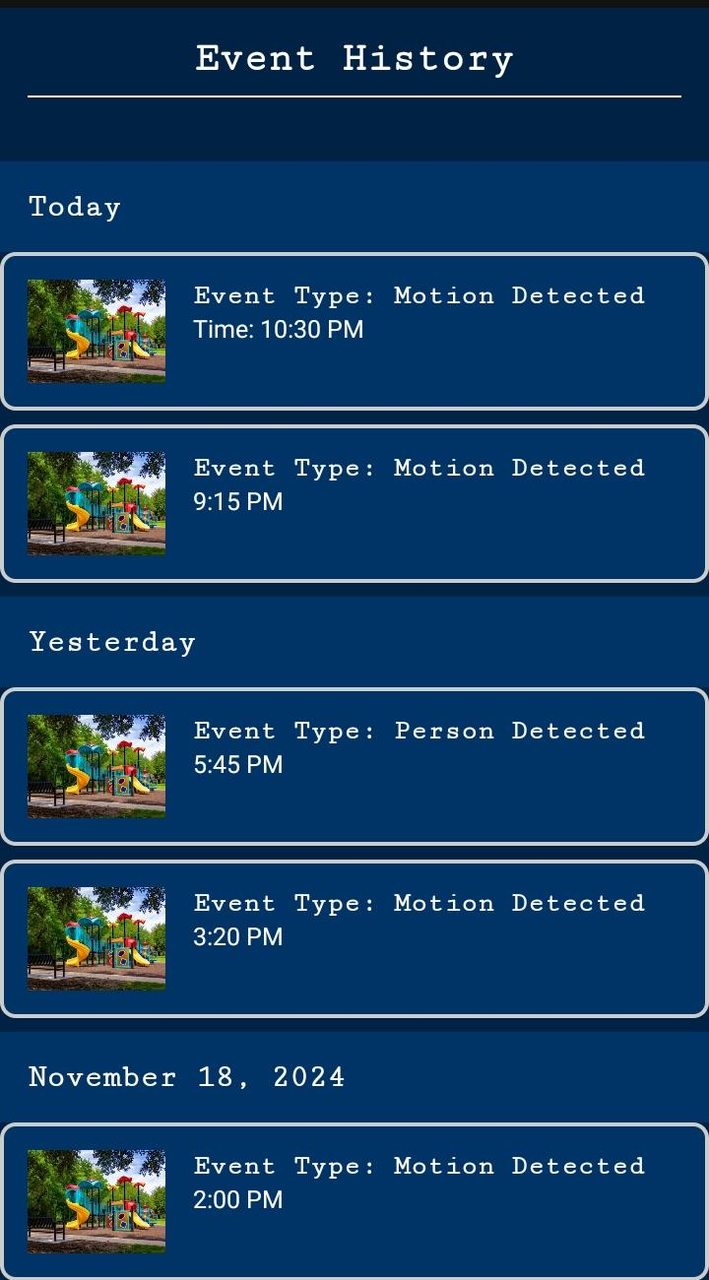
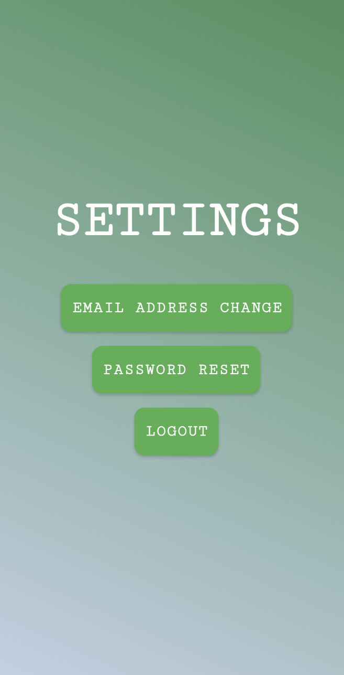
Subsystem 4: App Main Page
Main Page:
Latest thumbnail displayed
Charging Statistics
System Controls
Event History:
Events sectioned by date recorded
Event Type and Time
Settings:
Log Out
Email Change
Password Reset
FAQ (TBC)

Slide 12
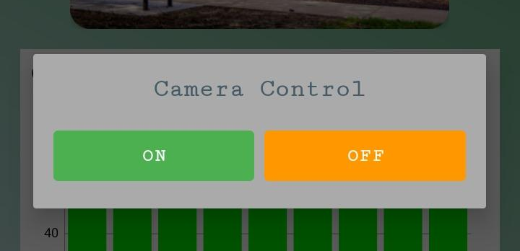

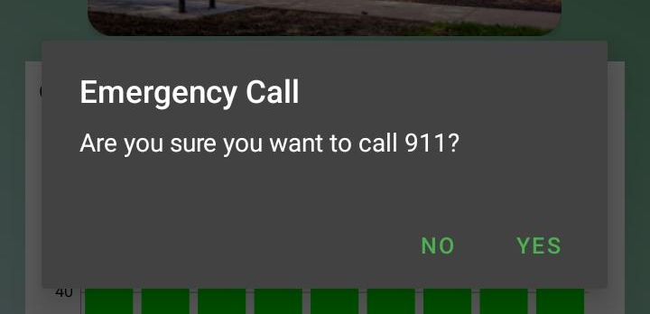
Subsystem 4: App System Controls
On/Off controls for Camera and LED Light (Ready to be Connected)
SOS Emergency Call (Connected Directly to Device)

Slide 15
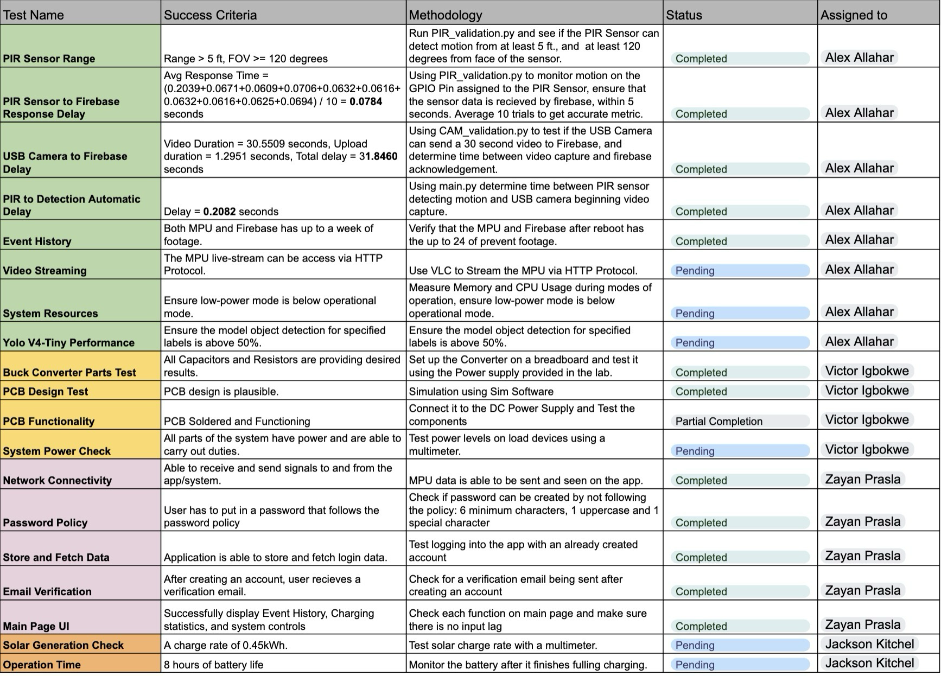
Validation Status

